Slide 1

Experiences with Massive Open Online Courses (MOOC)
Charles Severance
University of Michigan
School of Information
http://www.dr-chuck.com/
@drchuck

Slide 2
Quick Poll
Heard of the word MOOC?
Taken a MOOC?
Finished a MOOC?
M assively
O pen
O nline
C course

Slide 3
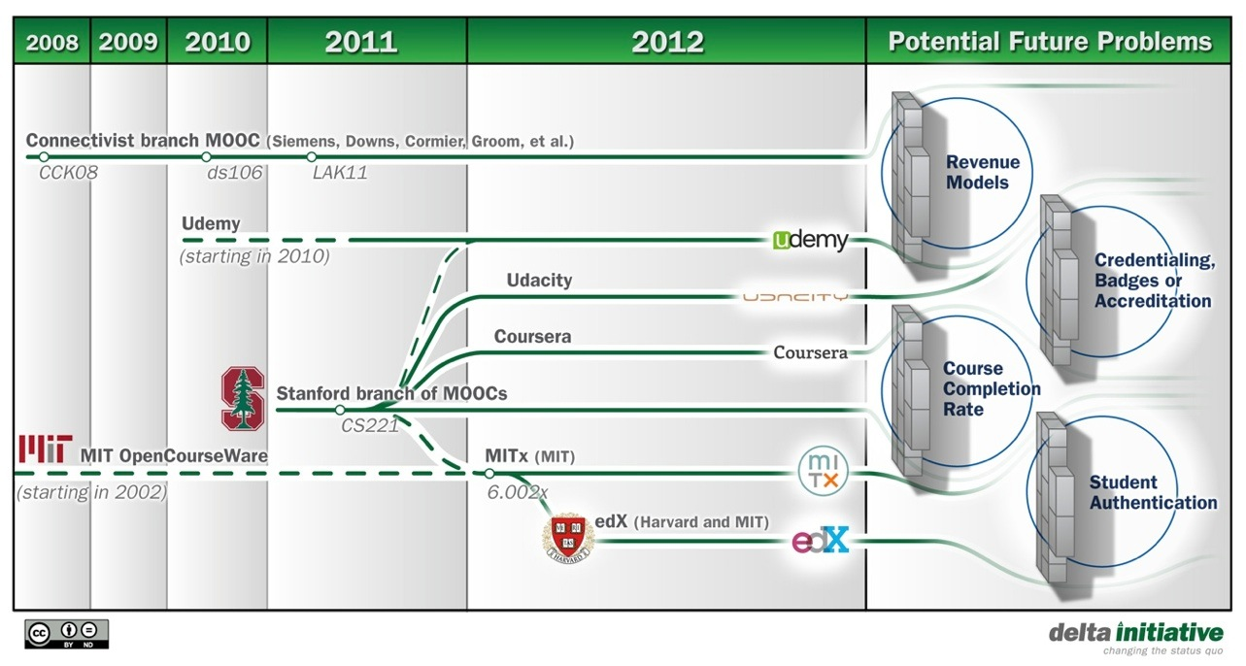

Slide 4
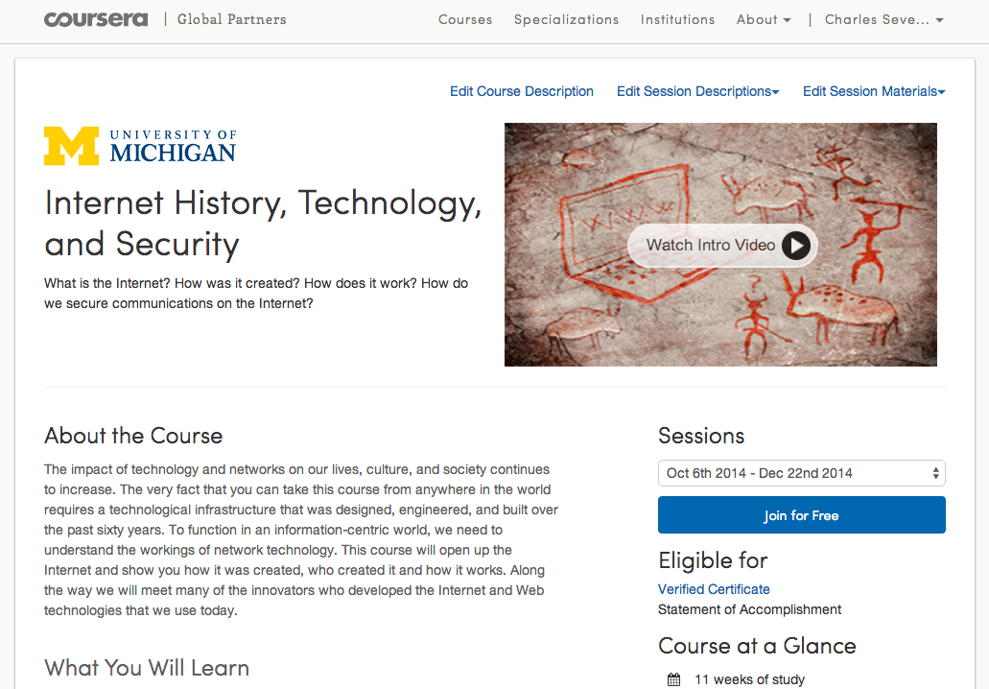

Slide 5
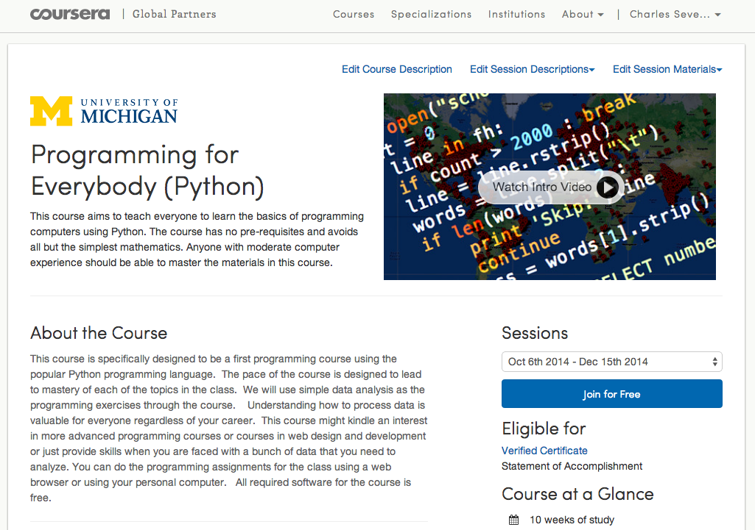
online.dr-chuck.com

Slide 6
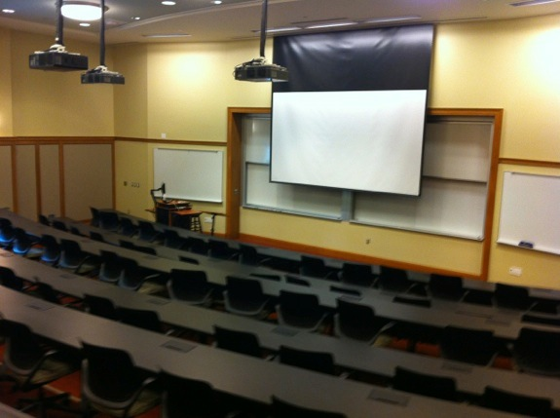
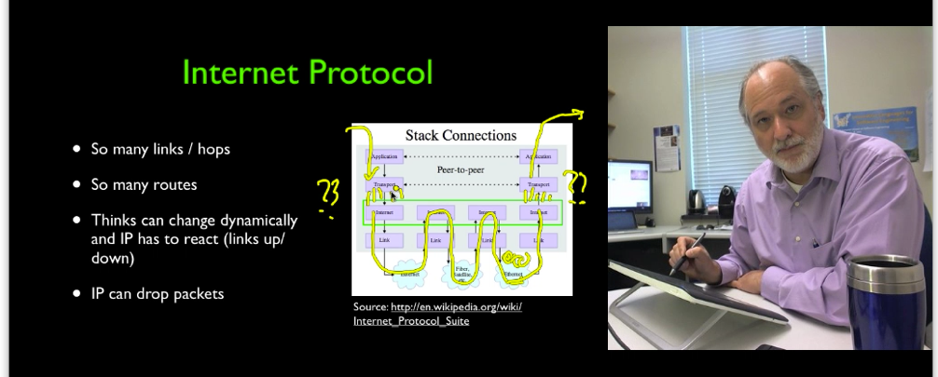

Slide 7
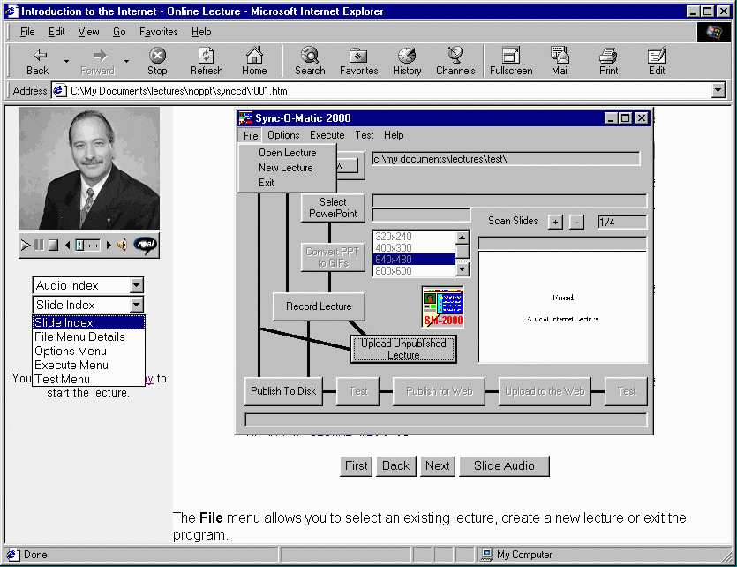
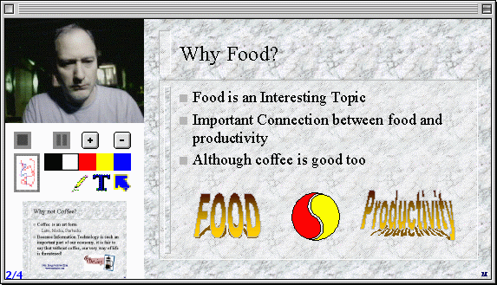
Clipboard - 2002
Syncomatic -1996

Slide 8
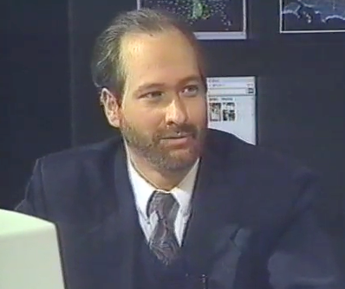
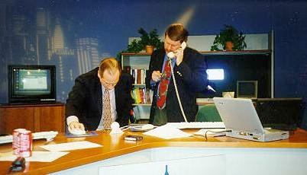
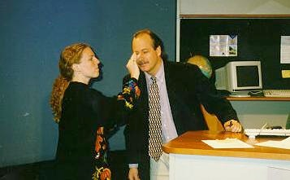
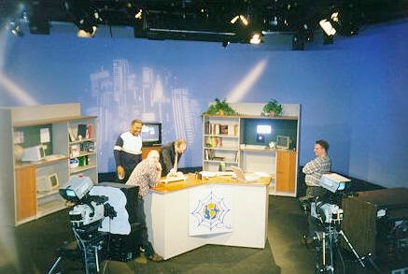
Internet: TCI
Nuthin' But Net

Slide 9
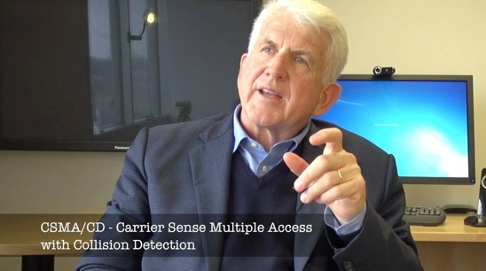
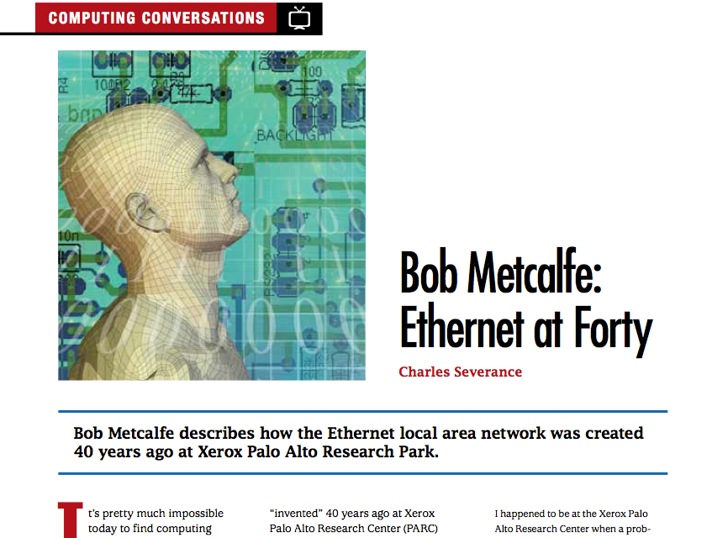

Slide 10
About the course...

Slide 11
A Bit of Data...

Slide 12
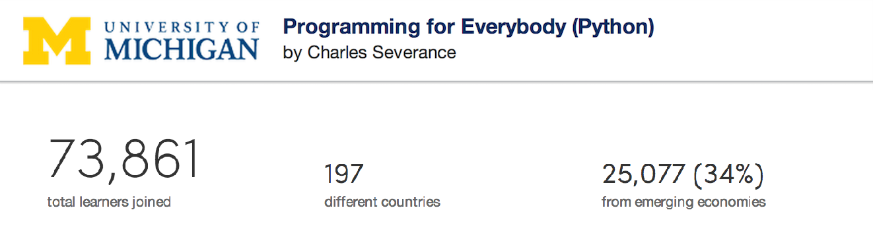
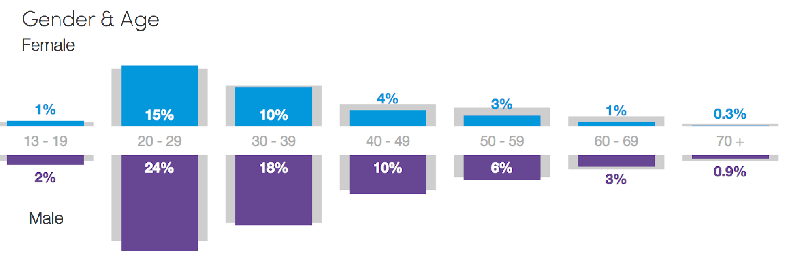

Slide 13
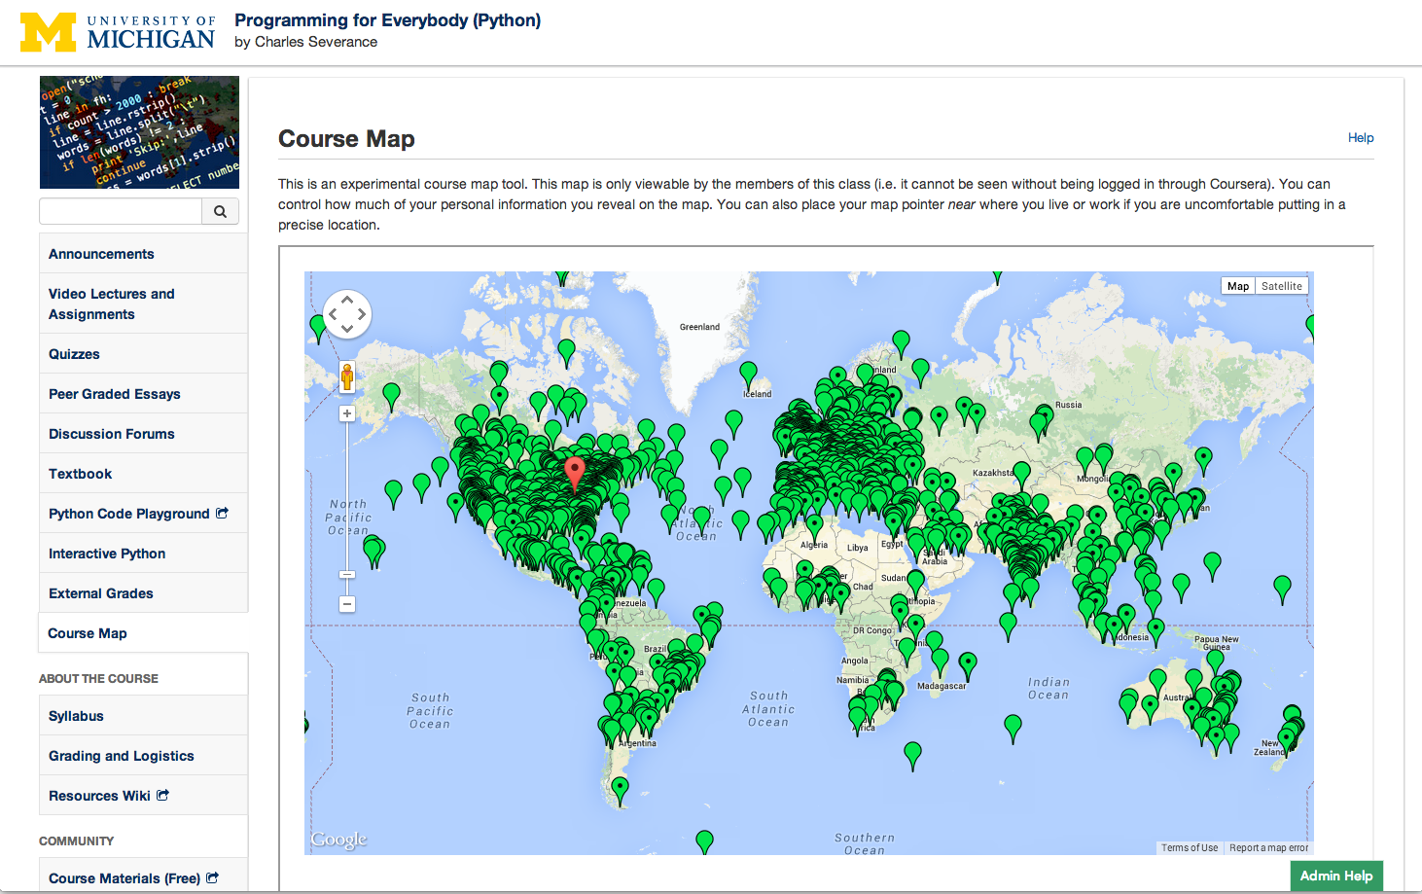

Slide 14
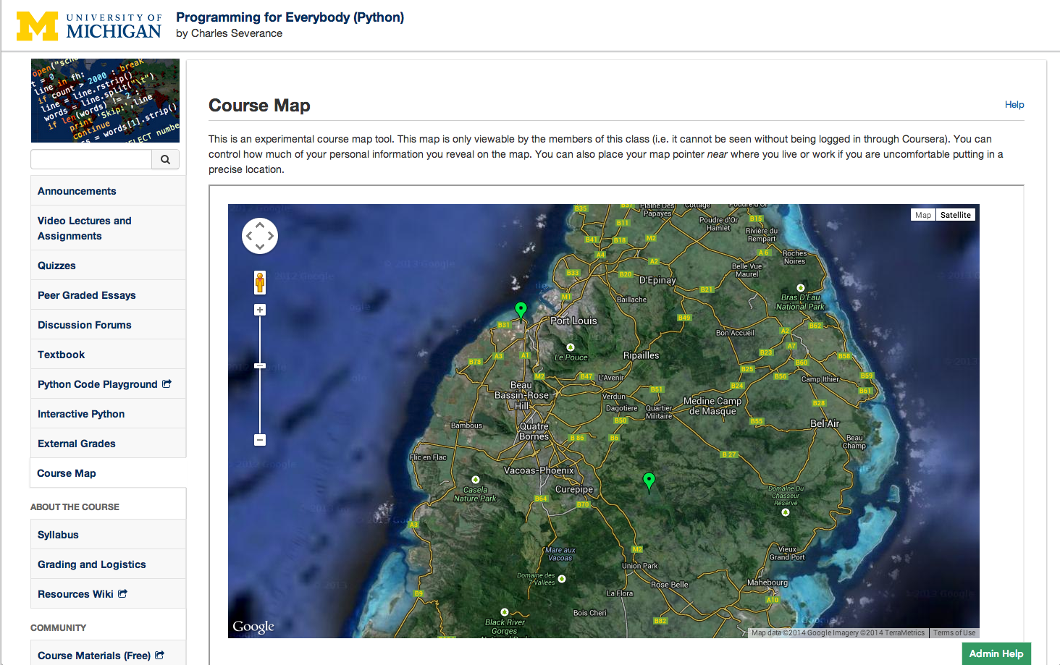
Mauritas

Slide 15
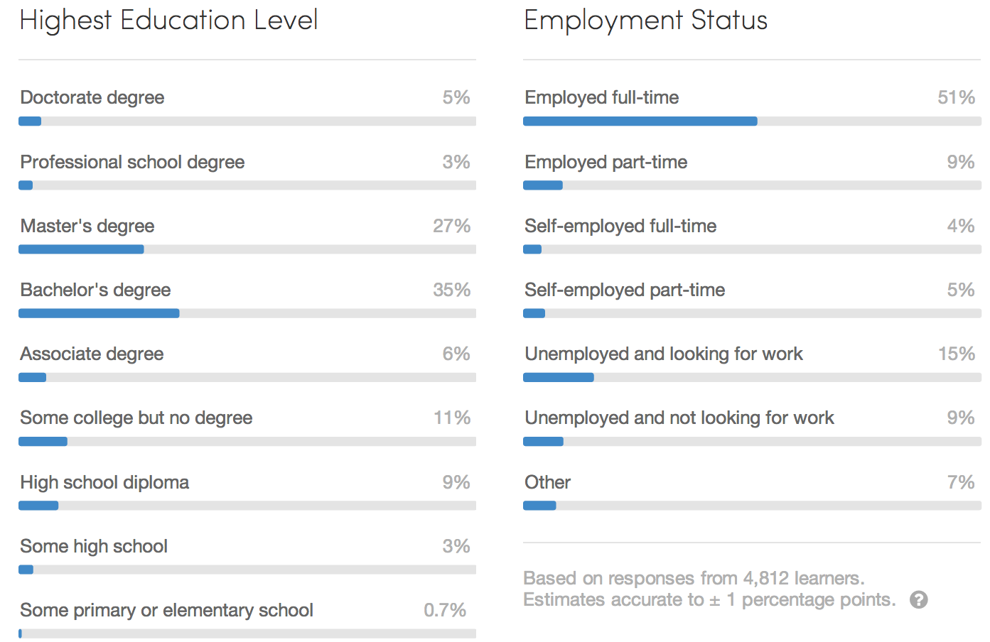

Slide 16
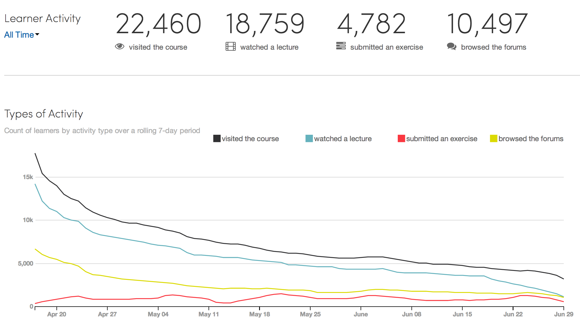
PR4E#1

Slide 17
My Approach to MOOCs

Slide 18
Introductory Courses
We needed low-stakes "freshman" courses in Coursera
How to behave
How to use the software
How to write
Figure out technical issues
How to learn from others and help others learn....

Slide 19

Be an Open Learning Community
Open Source works well when there is a "Benevolent Dictator"
There needs to be real and enforced rules - but as few as possible
Those in power must not hide behind their power and must share their power with those who show the right behavior
Must make valued behaviors "infectious" / "amplified"

Slide 20
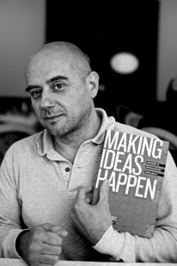
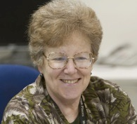
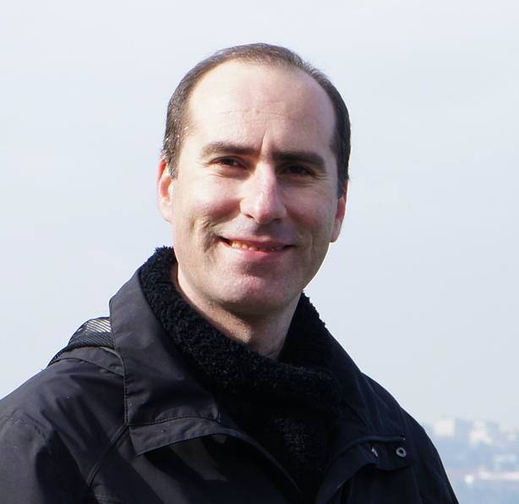
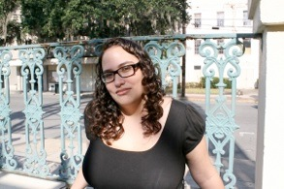
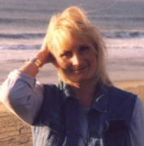
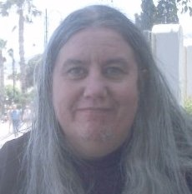
Community Teaching Assistants
Volunteer students from prior sessions
Culture forms very rapidly
Questions answered quickly
Mauro - Italy
Sue - CA
Megan - UK
Mazen - Egypt
Susan - PA
Karen - NC

Slide 21
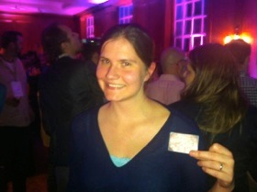
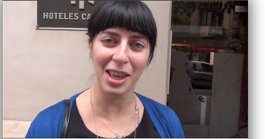
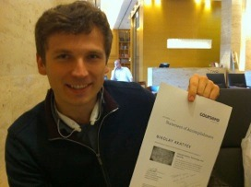
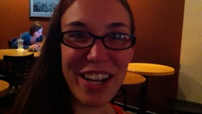
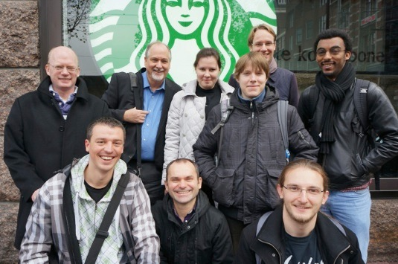
New York NY, Los Angeles CA, Ann Arbor MI, Wilmington, NC, Chicago IL, Washington, DC, Memphis, TN, Seattle WA, Seoul, Barcelona, London, Amsterdam, Melbourne, Perth
http://youtu.be/GD9RSoVDKkw

Slide 22
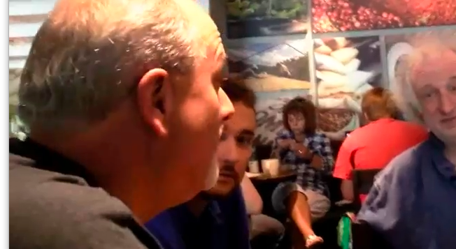
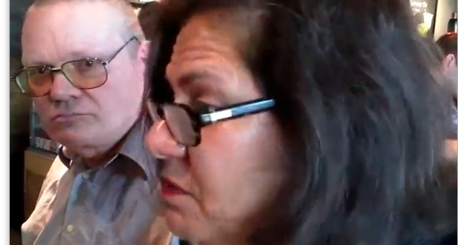
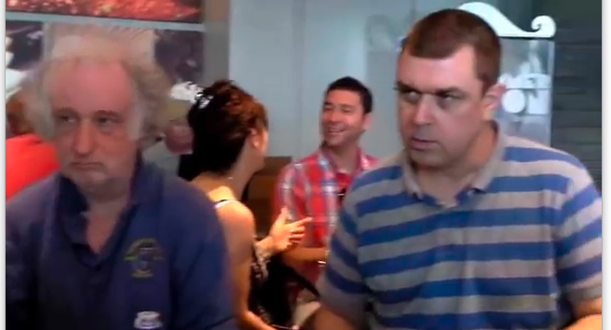
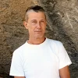
Thanks to
Nico Morrison
http://www.youtube.com/watch?v=BsSKYzVLO6w

Slide 23
Making More Teachers

Slide 24
Create / Empower New Teachers
I don't beleive that all students in the world should consider me their teacher in this space
I wrote a "book"- I want others to adopt it and re-mix it
Related to making a "learning community"
oer.pr4e.org

Slide 25
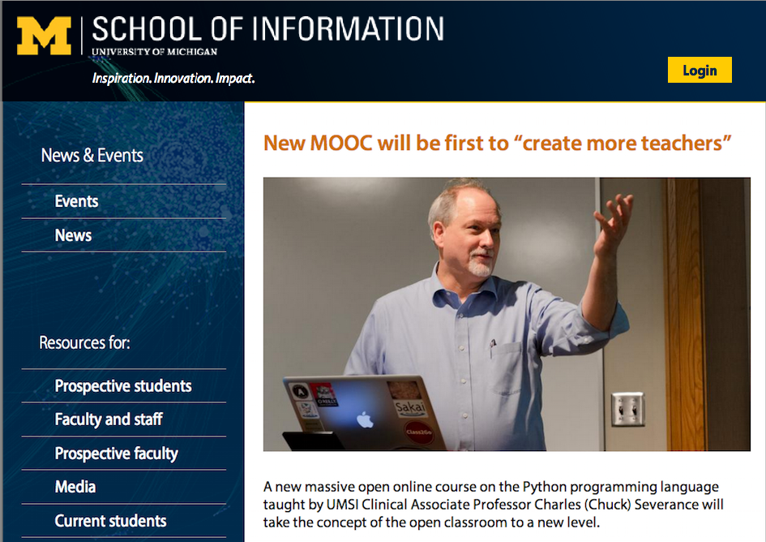

Slide 26
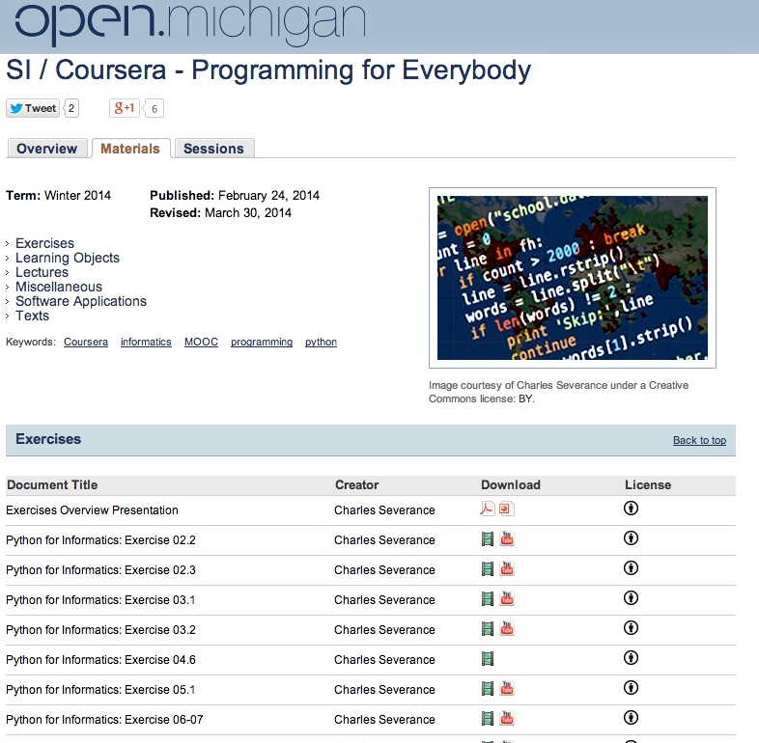

Slide 27
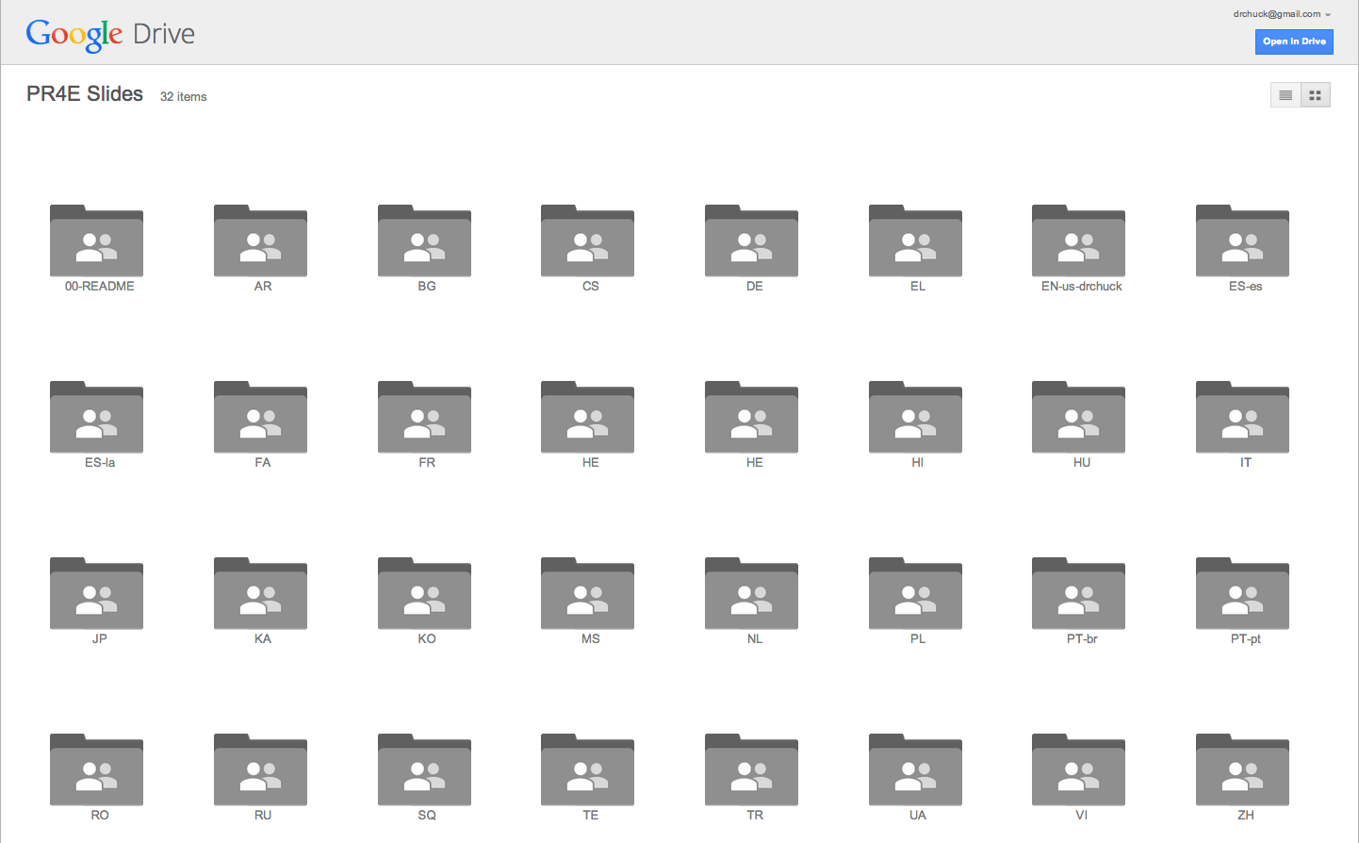
30 Languages / 157 volunteers

Slide 28
What's Free...
Course Enrollment
Statement of Accomplishment
Book: PDF, MOBI, EPUB, iBooks (CC-BY-NC*)
Lecture Slides in editable form (CC-BY)
Lecture Videos in MP4 or YouTube (CC-BY)
Auto-Grader software integrated into any LMS
* I will remove NC for a legitimate translation

Slide 29
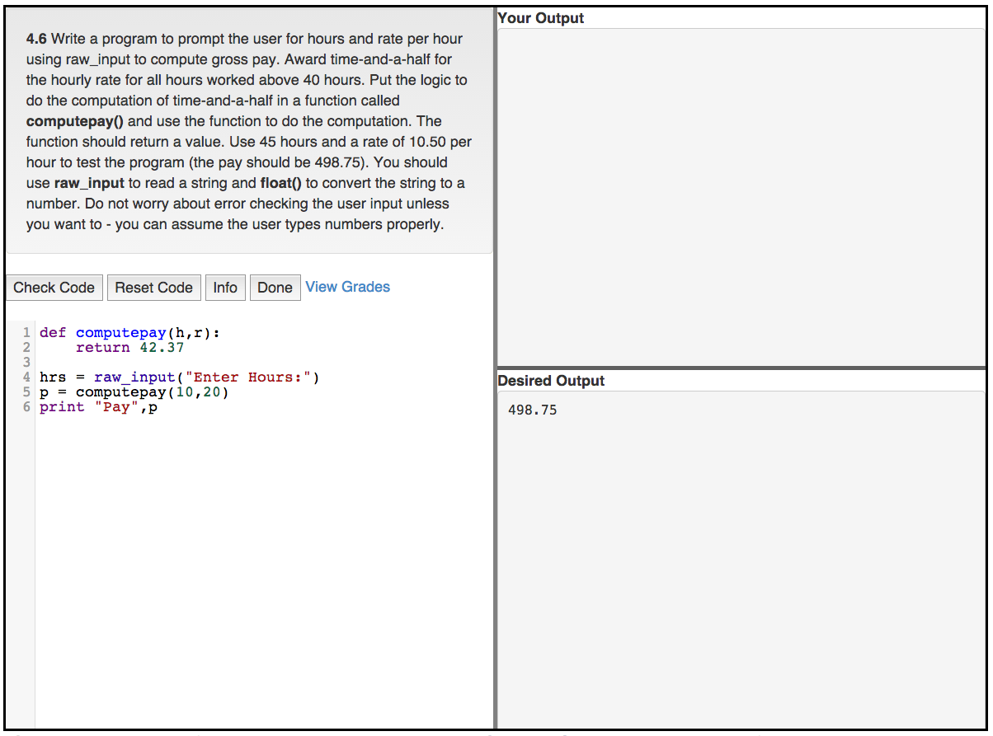

Slide 30
September 26, 2013
Dr. Chuck,
I am a professor at UC Irvine and took your Coursera Internet course last spring. I enjoyed it immensely! You are really a great teacher and I can learn a lot from you about teaching style. I took your course because I had designed a course in 2008 at UCI on "Internet, Technology, and Society".
You have licensed your slides under the Creative Commons Attribution 3.0 license and I would like to request permission to use some of your slides to teach this session. Of course I won't be able to fit all of them into one session but I would like to pick some. I will also likely change them to adapt to the class (these are mostly freshman from all majors). And of course I will acknowledge that these were created by you and will give free advertising to take your Coursera course.
Again, I want to emphasize how much I enjoyed your class!
Gloria Mark

Slide 31
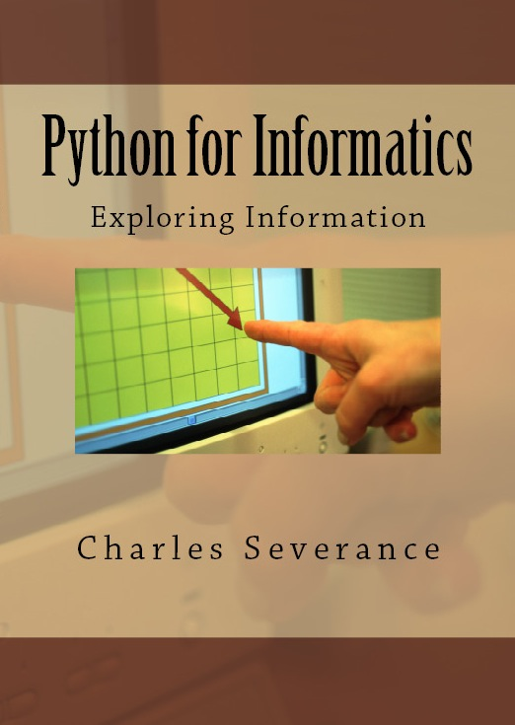
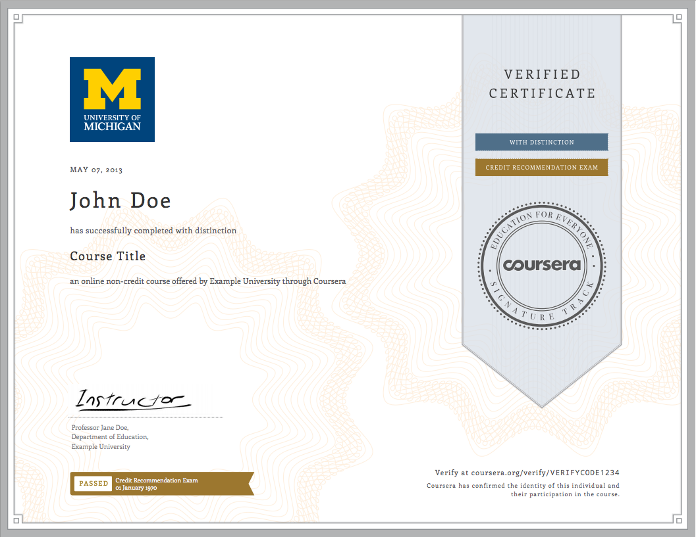
Revenue is Optional
Print Textbook ($8.99)
Conversion rate 1/200 – Revenue $2.50
Verified Certificates ($40.00)
Conversion rate 1/100 – Revenue $2.00
Session 1: 30497
Session 2: 73,861

Slide 32
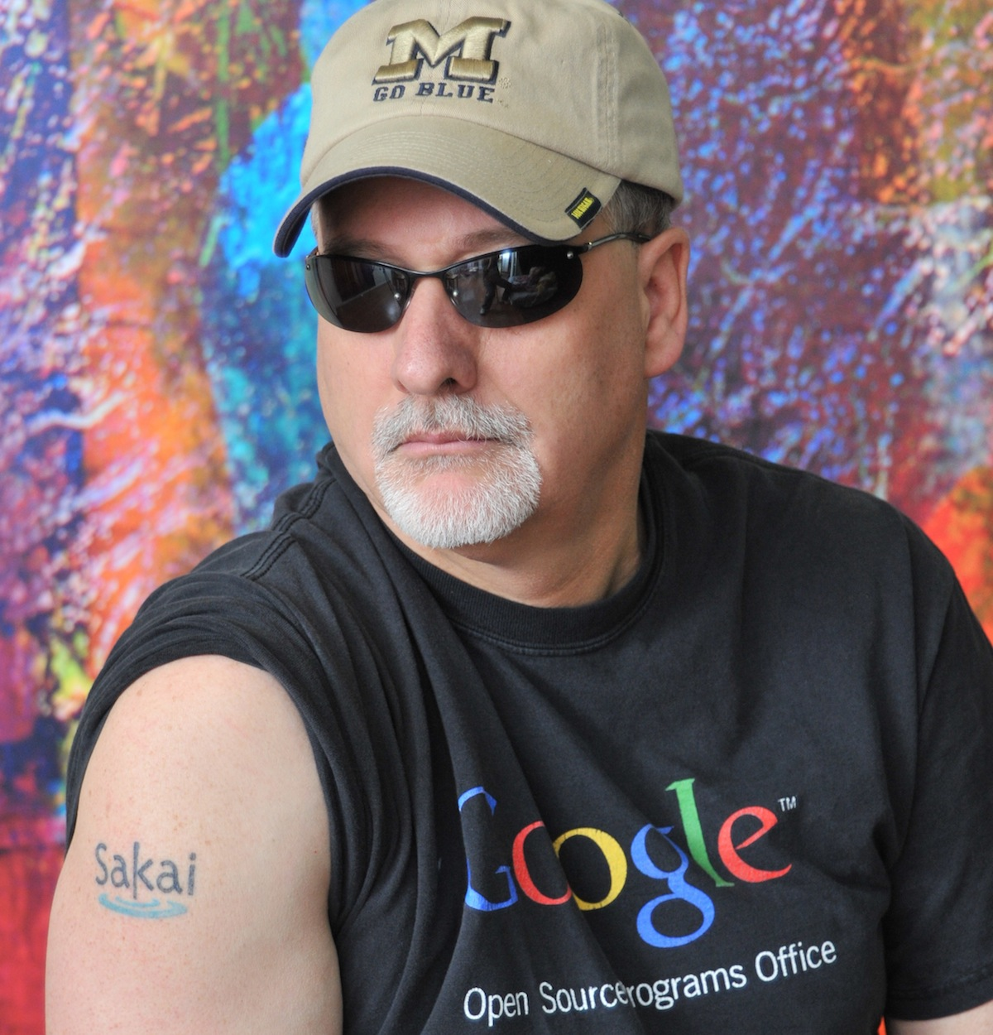
Teacher Prep
Book
Value
Proposition
Software
Free (or $9)
Marketing
Community

Slide 33
Conversation Starters

Slide 34
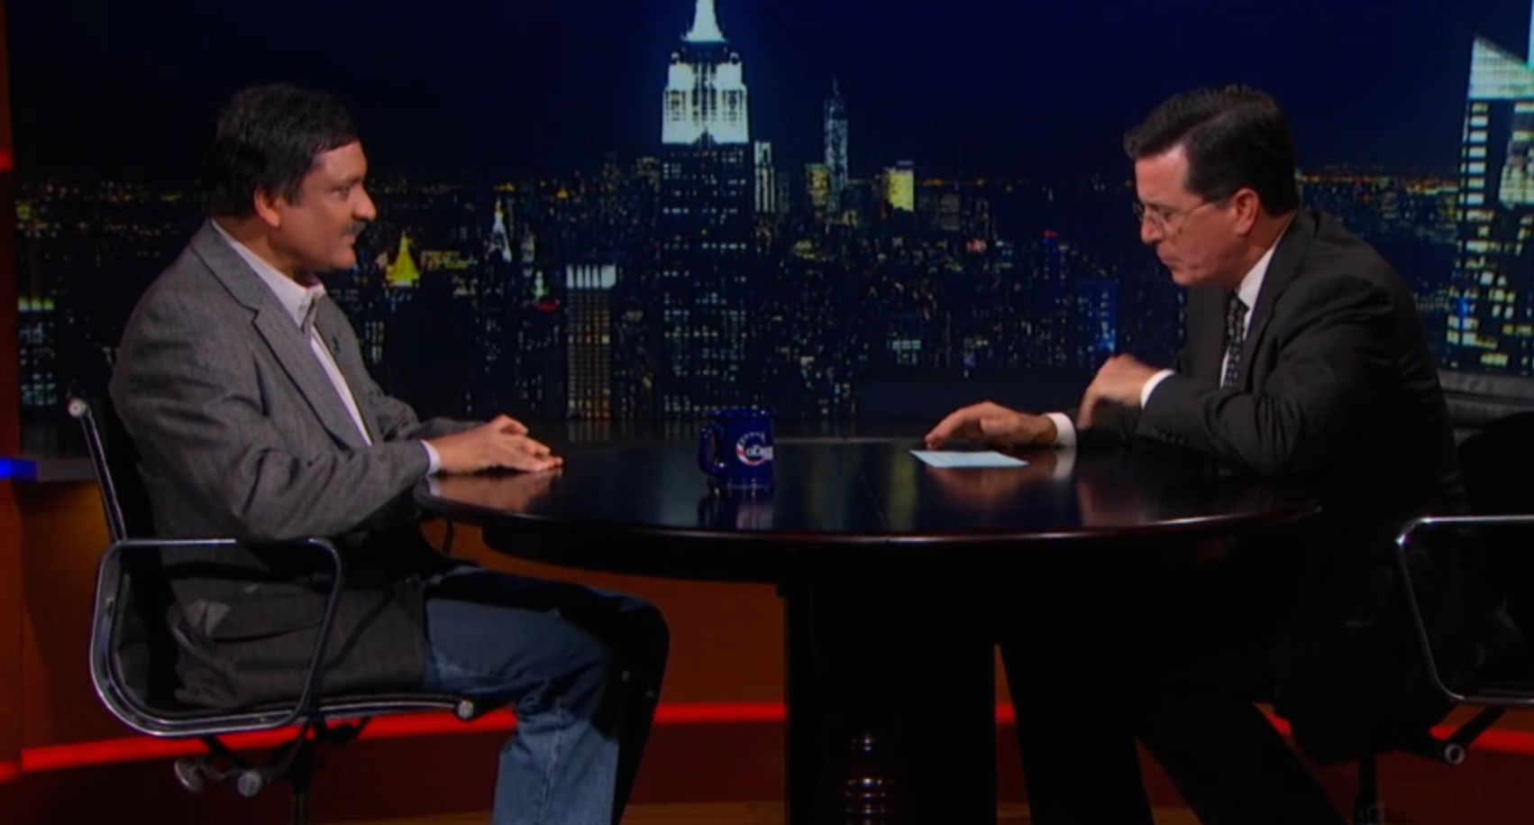
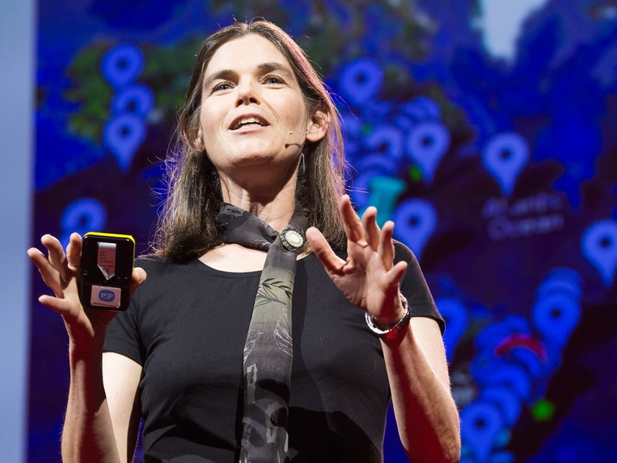
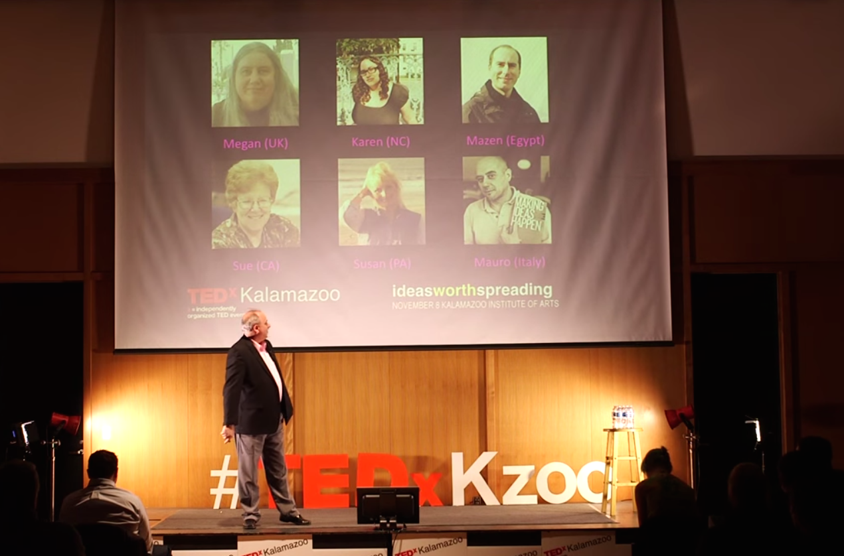
Too
Much
Hype?
http://thecolbertreport.cc.com/videos/zwqhae/anant-agarwal
http://tedxtalks.ted.com/video/MOOCs-Charles-Severance-at-TEDx
http://www.ted.com/talks/daphne_koller_what_we_re_learning_from_online_education

Slide 35
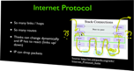
Is this New?

Slide 36

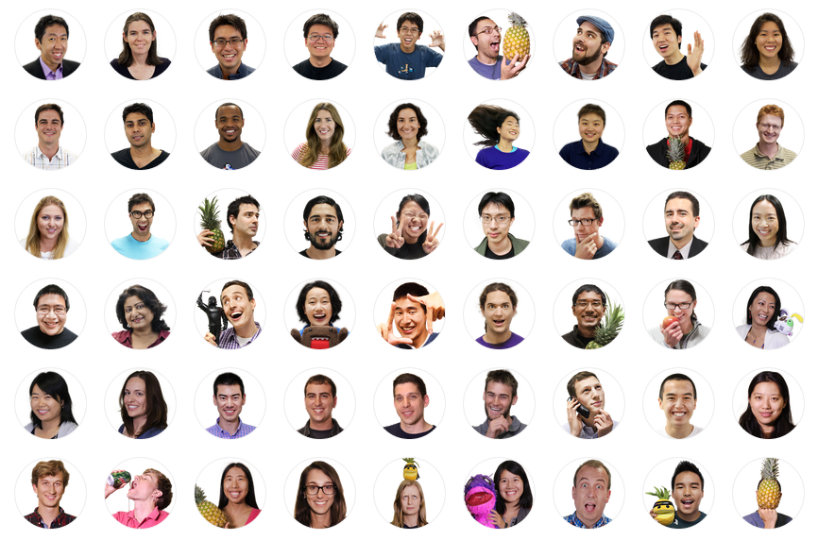
Coursera has over 6 Million Students
Is there a business model?

Slide 37
Is this a failure of MOOCs or simply our first encounter with real Personalized Learning or Self Directed Learning?
http://mfeldstein.com/emerging-student-patterns-in-moocs-a-revised-graphical-view/

Slide 38




Teaching or Measuring?

Slide 39
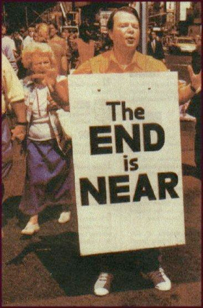
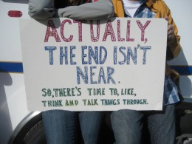
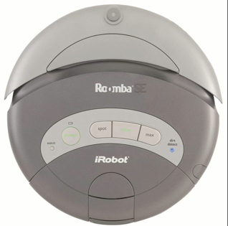
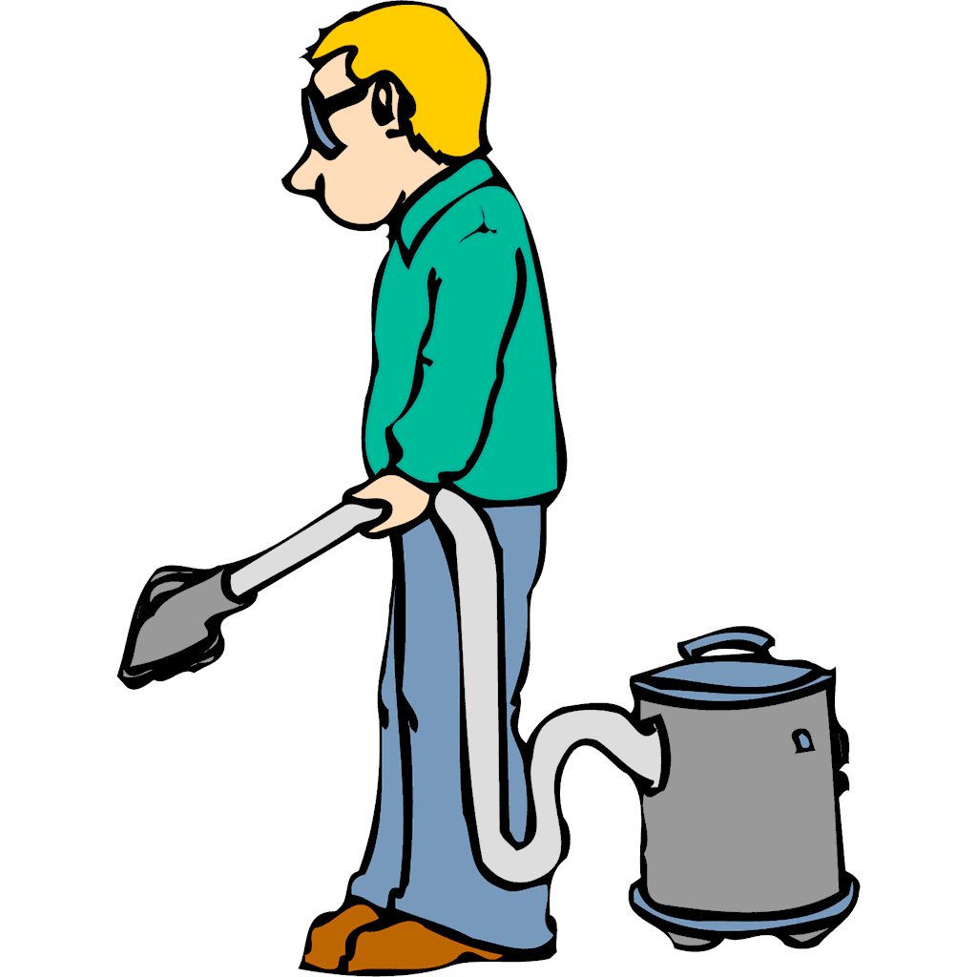
The End of Higher Education?
http://cliparts101.com

Slide 40






The
Story
Tellers
$12.50
$13.08
$18.90

Slide 41


What about the students?
http://en.wikipedia.org/wiki/B._F._Skinner

Slide 42


How can we improve education?

Slide 43
A Few Predictions
Online "continuation" Masters degrees have a limited lifetime
For-profit undergraduate online programs will become very niche
Residential schools must leverage being together - do more
Remedial / preparation / just in time / continuing ed / professional development - wil be free and high quality
Truly democratizing education will happen - but require re-commitment to open educatonal resources and remixable resources

Slide 44



Thank you.
Notes:
I learned a lot from you about the nature of teaching and learning.
Got a certificate with a strong score. Got 8/10 on one of the writing extra credit assignments and got a 28 on the final.

